Slide 1
Lab 9
Method only classes
Static Methods
Try Catch Blocks
FileReader class
Scanner class

Slide 2
Method only class
ArrayUtilities
+findMax(int[] numbers):int +findMin(int[] numbers):int +findIt(int[] numbers, int wanted): String
No constructor
No assessors
No modifiers

Slide 3
Static methods

Slide 4
Should our methods be static?
Static methods in java belong to the class (not an instance of it). They use no instance variables and will usually take input from the parameters, perform actions on it, then return some result.
Terminology:
instance variable = member variable = field= class property

Slide 5
Should our methods be static?
Does it make sense to call a method if no Object has been created yet?
Can I call calcAge() without making a Friend first?
Can I call findMax(int[] nums) without making a ArrayUtilities object?

Slide 6
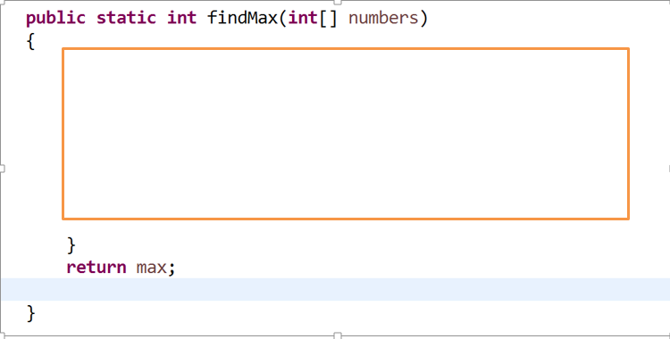
How do I make a method static?

Slide 7
How do I call a static method?
ClassName.methodName()
Remember the Math class- all its methods are static
System.out.println(Math.sqrt(26));
Calling findMax
System.out.println(ArrayUtilities.findMax(myArray));

Slide 8
Static classes
Static classes are basically a way of grouping classes together in Java. Java doesn't allow you to create top-level static classes; only nested (inner) static classes

Slide 9
Method only class (static methods)
UML class diagram
ArrayUtilities
+findMax(int[] numbers):int +findMin(int[] numbers):int +findIt(int[] numbers, int wanted): String
Note: static methods are underlined

Slide 10
In Main

Slide 11
Adding in ArrayLists
ArrayAndListUtilities
+findMax(int[] numbers):int +findMax(ArrayList<Integer> numbers):int +findMin(int[] numbers):int +findMin(ArrayList<Integer> numbers):int +findIt(int[] numbers, int wanted): String +findIt(ArrayList<Integer> numbers, int wanted): String
Note: static methods are underlined in UML class diagrams

Slide 12
Exceptions
Runtime exceptions
Checked exceptions

Slide 13
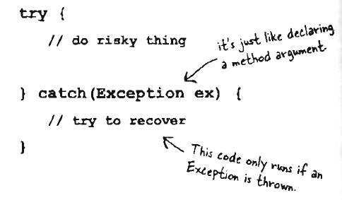
An exception is an object of type Exception

Slide 14
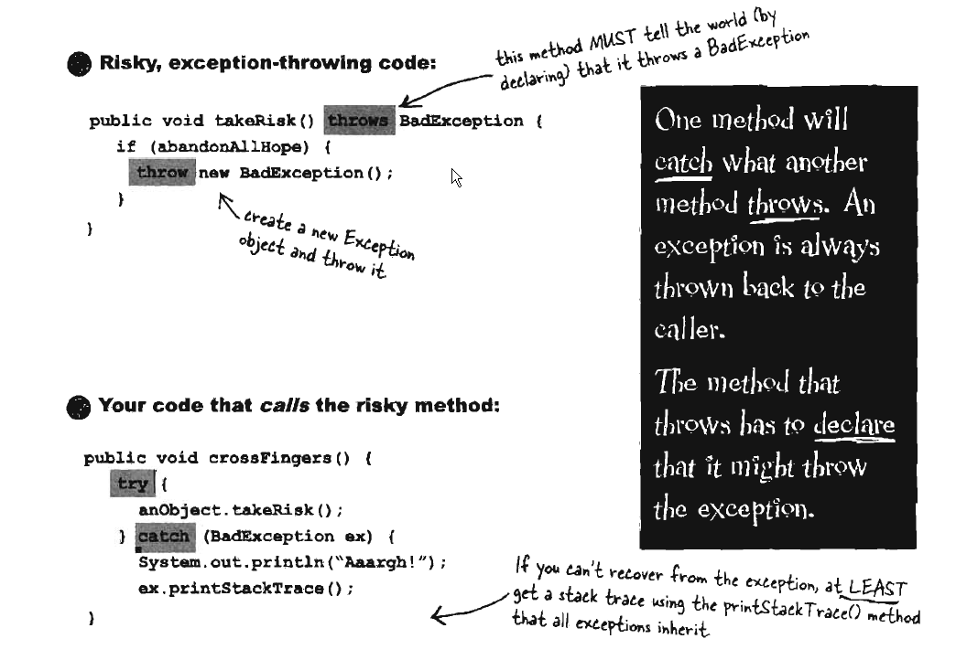
If it's yourcode that catches the exception, then, whose code throws it?

Slide 15
Try Catch Blocks
int num =13, denom = 0,result;
result = num/denom;
We get the following run-time error
Exception in thread "main" java.lang.ArithmeticException: / by zero
at ptrycatch.Try1.main(Try1.java:21)
Java Result: 1
BUILD SUCCESSFUL (total time: 0 seconds)

Slide 16
try catch block
init:
deps-jar:
Compiling 1 source file to H:\NetBeans\PTryCatch\build\classes
compile:
run:
Error :attempting to divide by zero
BUILD SUCCESSFUL (total time: 0 seconds)
int num =13, denom = 0,result;
try
{
result = num/denom;
}
catch (ArithmeticException e)
{
System.out.println("Error :attempting to divide by zero");
//or
System.out.println(e.getMessage());
}
/ by zero

Slide 17
IndexOutOfBoundsException
int[] myArray = new int[10];
myArray[0] = 8;
myArray[10] = 2;
Exception in thread "main" java.lang.ArrayIndexOutOfBoundsException: 10
at ptrycatch.Try3.main(Try3.java:16)
Java Result: 1

Slide 18
Can have multiple catches
int[] myArray = new int[10];
try
{
myArray[0] = 8;
myArray[10] = 2;
}
catch(IndexOutOfBoundsException e)
{
System.out.println("out of bounds error");
}

Slide 19
finally
Program flow continues after the catch method unless in the catch there is System.exit(0);
catch(IndexOutOfBoundsException e)
{
System.out.println("out of bounds error");
}
finally
{
System.out.println("program continues on");
}

Slide 20
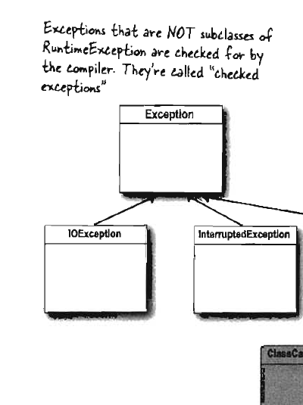
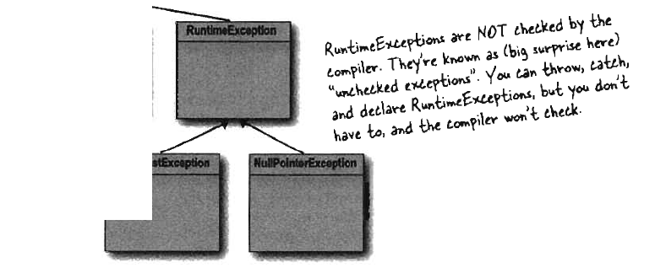
ArithmeticException and IndexOutOfBoundsException are runtime exceptions

Slide 21
Checked Exceptions

Slide 22
Reading a file
Put the file at the top level of the project folder
Everything is a stream
File f = new File(“rand.txt”);
FileReader fr = new FileReader(f);
BufferedReader bf = new BufferedReader(fr);
File
FileReader
BufferedReader

Slide 23
In one line
BufferedReader in = new BufferedReader(new FileReader(“rand.txt”))
String line;
//get one line
line =in.readLine();

Slide 24
exceptions
in = new BufferedReader(new FileReader("rand.txt"));
while (((line = in.readLine()) != null) && (index < 1000)) {
//turn the input into an integer
myArray[index] = Integer.parseInt(line);
index++;
}
Errors:
unreported exception java.io.FileNotFoundException; must be caught or declared to be thrown
in = new BufferedReader(new FileReader("rand.txt"));
unreported exception java.io.IOException; must be caught or declared to be thrown
while (((line = in.readLine()) != null) && (index < 1000)) {
2 errors
BUILD FAILED (total time: 1 second)

Slide 25
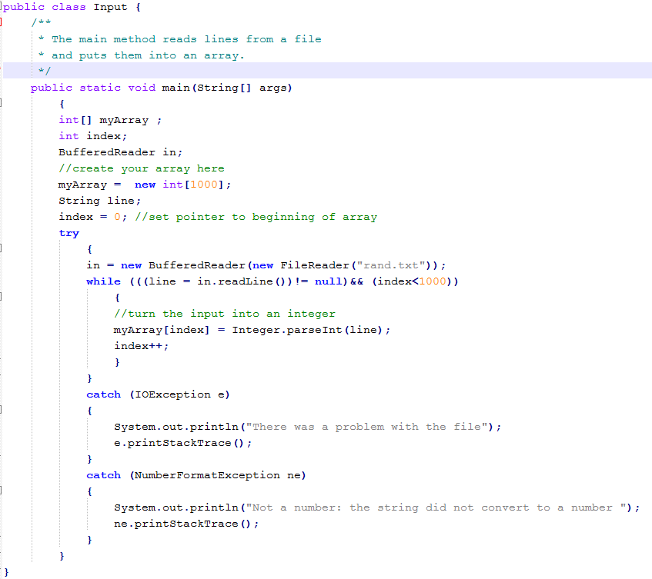

Slide 26
Solution
Surround with a try catch
see code above
Or you could throw the exception (This is not a good solution!!!!)
This is called ducking
Adding a throws clause
public static void main(String[] args) throws IOException {

Slide 27
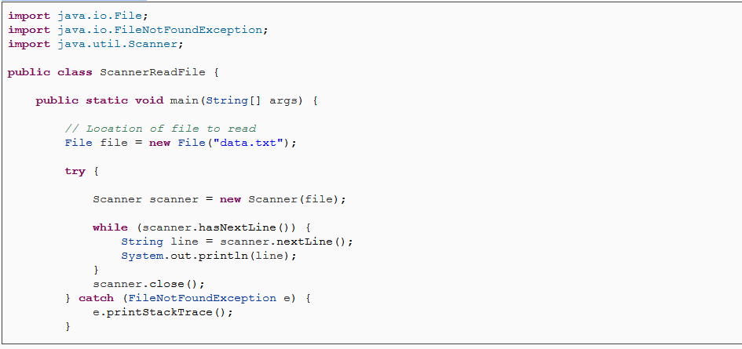
Scanner class

Slide 28
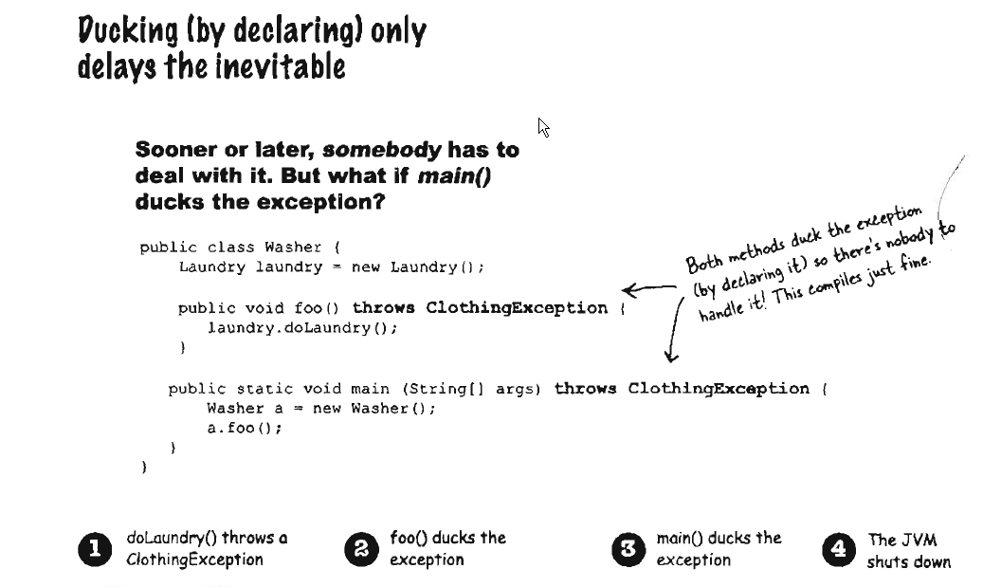
Notes:
Pretend here that something goes wrong in the doLaundry method and an error gets thrown

Slide 29
Testing for a class throwing an exception in Unit 5 (Jupiter)
@Test
public void itShouldThrowNullPointerExceptionWhenBlahBlah()
{
assertThrows(NullPointerException.class,
()->{
//do whatever you want to do here
objectName.thisMethodShouldThrowNullPointerExceptionForNullParameter(null);
});
}

Slide 30
Testing for a class throwing an exception in Unit 5 (Jupiter)
@Test
public void shouldRaiseAnException() throws Exception
{
int[] numbers =null;
Assertions.assertThrows(NullPointerException.class,
() ->{
ArrayAndListUtilies.findMax(numbers);
});
}

Slide 31
Testing for a class throwing an exception in Unit 4 and below
@Test(expected = Exception.class)
public void shouldRaiseAnException() throws Exception
{
int[] numbers =null;
ArrayAndListUtilies.findMax(numbers);
}

Slide 32
Testing whether 2 collections are equal
Arrays
  assertArrayEquals(numbers1, numbers2);
Lists
  assertIterableEquals(listOne, listTwo);

Slide 33
Writing to a file
PrintWriter
See code

Slide 34
